Slide 1
GROWTH CURVE
Dr. Reshma Reghu
Assistant Professor
Dept of Community medicine

Slide 2
GROWTH CHART
Road-to-health" chart
It is a visible display of the child's physical growth and development.
It is designed primarily for the longitudinal follow-up (growth monitoring) of a child, so that changes over time can be interpreted.
It is important to note that in the weight-for-age chart, the height of the child is not taken into consideration. This is because weight is the most sensitive measure of growth, and any deviation from "normal" can be detected easily by comparison with reference curves
offers a simple and inexpensive way of monitoring weight gain

Slide 3
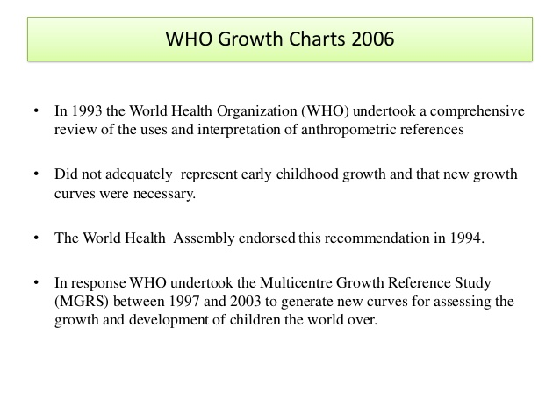

Slide 6
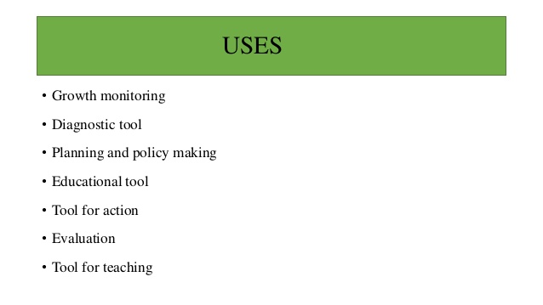

Slide 7
CARE OF THE PRE-SCHOOL CHILD
Children between 1-4 years of age are generally called pre-school age children or toddlers.
The pre-school age is distinguished by the following characteristics :
Large numbers
Mortality
Morbidity
Growth and development
Accessibility
Prevention in childhood of health problems in adult life

Slide 8
LARGE NUMBERS
Pre-school age children (1-4 years) represent about 9. 7 per cent of the general population in India.
A large majority of these children live in rural and tribal areas and in urban slums.
They are entitled to a large share of health and social services.
Children are the human resources of the future.
Their development is in the interest of the total national development; they need special attention.

Slide 9
Mortality
The pre-school age (1-4 years) mortality in India is 2.3 per cent of all deaths.
due to infection and malnutrition is characteristic of this age group in underprivileged areas.
Malnutrition was shown to be an underlying cause in 3.4 per cent of all deaths in young children and associated cause in no less than 46 per cent

Slide 10
Morbidity
Children in this age group are usually victims of PEM accompanied by retarded growth and development.
main morbidity problems are malnutrition and infections.
The prevalence of severe protein-energy malnutrition ranged between 5-6 per cent, and mild protein energy malnutrition about 40 per cent.
PEM is often associated with other nutritional deficiency such as anaemia, xerophthalmia, etc. Diarrhoea, diphtheria, tetanus, whooping cough, measles and other eruptive fevers, skin and eye infections, and intestinal parasitic infestations are usually common under the existing environmental conditions.
Atleast 5 per cent of the pre-school age children belonging to poor socio-economic groups show signs of vitamin A deficiency.
Accidents are also becoming frequent, especially burns and trauma from home accidents, and to an increasing degree, traffic accidents.
Some childhood diseases and conditions do not kill their victims, but cause serious disability (e.g., blindness, paralysis); and some diseases become manifest later in life (e.g., heart disease and mental retardation).
In many developing countries, periods of illness take up 25-30 per cent of the child's life and each represents either loss of weight or failure to gain weight.

Slide 11
Growth and development
Any adverse influences operating on children during this period (e.g., malnutrition and infection) may result in severe limitations in their development, some of which at least are irreversible.
The concept of vulnerability calls for preventive care and special actions to meet the biological and psychological needs inherent in the process of human growth and development

Slide 12
Accessibility
Special inputs are needed (e.g., day care centres, play group centres, children's clubs) to reach the toddler and to bring him into the orbit of health care.

Slide 13
Prevention in childhood of health problems in adult life
Events in early life (e.g. child's diet, infections) can affect the health when they becomes an adult, and can be prevented through early action, for example, dental diseases in adulthood.
Early treatment of streptococcal infection can prevent rheumatic heart disease.
Obesity, hypertension, cardiovascular diseases, and certain mental disorders may be laid in early life.
Some of the chronic orthopaedic ailments of the adult are probably connected with anomalies in the development or minor uncorrected infirmities of the infant (e.g. talipes, congenital dislocation of the hip).
Since young children are "vulnerable" to social and health hazards which can retard or arrest their physical and mental development during these critical years, they deserve special attention by the administration, general population and the family.

Slide 14
CHILD HEALTH PROBLEMS
1. low birth weight
2. malnutrition
3. infections and parasitosis
4. accidents and poisoning
5. behavioural problems.

Slide 15
At present in India 43.5 per cent children under 5 years age are underweight.
43 per cent moderate to severe cases,
16 per cent severe malnutrition, of these,
20 per cent have moderate to severe wasting and
48 per cent moderate to severe stunting

Slide 16
Malnutrition makes the child more susceptible to infection, recovery is slower and mortality is higher.
Malnutrition in infancy and childhood leads to stunted growth.
It also manifests by clinical signs of micronutrient and vitamin deficiencies.
Prevention and appropriate treatment of diarrhoea, measles and other infections in infancy and early childhood are important to reduce malnutrition rates.
Exclusive breastfeeding in first 6 months of life is very important

Slide 17
37 per cent of the children in the developing world have low height for their age i.e. stunting
10 per cent children have low weight for height.
The rate of low height for age reflects the cumulative effects of
Under- nutrition and infections since birth or even before birth
high rates are often suggestive of bad environmental conditions and/or early malnutrition.
Greater frequency of low weight for height, often reflects current severe under-nutrition or disease.

Slide 18
Micronutrient malnutrition
Micronutrient malnutrition refers to a group of conditions caused by deficiency of essential vitamins and minerals such as vitamin A, calcium, iodine, iron and zinc.
It is estimated that about 2 billion people are affected by this type of malnutrition.
Vitamin A deficiency is still the most common cause of preventable childhood blindness world-wide;
iodine deficiency causes goitre, cretinism and brain damage; and
anaemia results from insufficient iron intake.

Slide 19
Nutritional anaemia
It affects all age groups, including pre-school children, school children and elders.
Even mild anaemia reduces resistance to fatigue.
It has a profound effect on psychological and physical behaviour.

Slide 20
Vitamin A deficiency
Young children are at greater risk of developing xerophthalmia, partly because their vitamin A requirements are proportionately greater than those of any other group andnpartly because they suffer most from infections.
The result is that severe, blinding corneal destruction is most frequently seen in children between the age of six months and six years.
Vitamin A deficiency is most frequent cause of blindness among pre-school children in developing countries.
Some 20 per cent children with this deficiency are at increased risk of death from common infections, and around 2 per cent are blinded or suffer serious sight impairment.

Slide 21
Iodine deficiency
Iodine deficiency disorders pose a public health problem as about 1.5 billion people are living in environments lacking this mineral.
30,000 babies are stillborn each year
Over 120,000 are born mentally retarded, physically stunted, deaf-mute or paralysed.
Even when children are born otherwise healthy, lack of iodine may still cause mental dullness and apathy.

Slide 22
Infectious and parasitic diseases
Young children fall an easy prey to infectious diseases.
The leading childhood diseases are : diarrhoea, respiratory infections, measles, pertussis, polio, neonatal tetanus, tuberculosis, and diphtheria.
The incidence increases with the aggravation of a state of malnutrition.
Of about 4 million deaths a year from acute respiratory infections in the developing world, a quarter are linked to malnutrition, and a further quarter associated with complications of measles, pertussis, malaria and HIV/AIDS.
During 2012, about 9 per cent of under-five mortality worldwide was due to diarrhoeal diseases, about 17 per cent due to ARI, about 1 per cent deaths were due to measles and about 7 per cent due to malaria.
In India, during the year 2013, 4,090 cases of diphtheria, 15, 768 cases of measles, 36,661 cases of pertussis, and 528 cases of neonatal tetanus were reported .
In the case of eruptive fevers, malaria, intestinal parasites such as ascariasis, hookworm, giardiasis and amoebiasis etc. which are common because of poor environmental sanitation and paucity of potable drinking water.
The prevention and treatment of children's illnesses may interrupt the transmission of infection in the community.

Slide 23
Accidents and poisoning
In the developed world, accidents and poisoning have become an important child health problem.
Accidents among children are frequent in the developing countries also, especially burns and trauma as a result of home accidents and, to an increasing degree, traffic accidents.
Children and young adolescents are particularly vulnerable to domestic accidents - including falls, burns, poisoning and drowning.

Slide 24
Behavioural problems
Behavioural disturbances are notable child health problem.
Children abandoned by their families present severe social and health problems.
Over 60,000 children are abandoned each year in India

Slide 25
Other factors affecting the health of children
Maternal health
Family
Socio-economic circumstances
Environment
Social support and health care

Slide 26
Maternal health
A major determinant of child health is the health of his/ her mother.
Child health is adversely affected (the risk begin to appear even before birth) if the mother is malnourished, if she is under 18 years (too young) or over 35 (too old), if her last child was born less than 2 years ago (too close), if she has already more than 4 births (too many) and if she is deprived of basic pregnancy care.
A healthy mother brings forth a healthy baby, with better chances of survival

Slide 27
Family
In pre-school years, the child is very much an organic part of the immediate family.
Whatever happens to him or her affects the other members of the family, and vice versa. Therefore, "child health" has to be "family health".
It depends upon the family's physical and social environment, which includes its lifestyle, customs, culture, traditional habits, and the childbearing and childrearing practices are greatly influenced by this.
The family and social environment has a considerable influence on the development of speech, personality and the intellectual potentials of the small child.
Other factors are the family size, the family relationships, and family stability.
Infancy and early childhood is the time when the child contracts common contagious illness from contact with others (older brothers and sisters, playmates, school-mates).
Data shows that the number of episodes of infectious diarrhoea increases with the size of the family.
Studies also show an increase in the prevalence of malnutrition in families with more than 4 children.
Fewer children would mean better nutrition, better health care, less morbidity and lower infant mortality.

Slide 28
Socio-economic circumstances
The socio-economic situation in which the family is placed is a very important factor in child health.
In every region of the world, the physical and intellectual development of children varies with the family's socioeconomic level.
Under-privileged children of the same age are smaller, lighter and less advanced in psychomotor and intellectual performance, compared to children of privileged group.
A detailed analysis of socio-economic factors shows the part played by the parents' education, profession and income, their housing, the urban or rural, industrialized or non-industrialized nature of the population.
Poverty, illiteracy (especially mothers' illiteracy) and sickness create a viscious circle spanning from one generation to the next, and from which it is difficult for the individual to escape.
The differences in health between rich and poor, which can be observed in all age-groups are particularly striking among children.

Slide 29
Environment
After the first week of a child's life, the environmental factors play a very great role as determinants of infant and childhood morbidity and mortality.
Tetanus infection of the newborn may take a heavy toll of the newborn in the first few weeks of life.
Diarrhoea, pneumonia and other infections bacterial, viral and parasitic - are extremely common in children exposed to insanitary and hostile environment.
The stages at which these infections occur vary according to the ecological conditions, home and family hygiene, local epidemiological conditions and the extent to which they come into contact with earth, water and above all with adults and other children.
An insufficient supply of safe water, inadequate disposal of human excreta and other waste, an abundance of insects and other disease carriers are among the environmental factors continuously menacing family health.
Another important factor which influences child development is environmental stimulations.
Children also develop skills if they are given the opportunity.
Stimulation, particularly the interaction with people who take interest and talk to them helps children to develop.
Other sources of environmental stimulation are the radio, TV and illustrated magazines.

Slide 30
Social support and health care
Other factors affecting the health status of children include community and social support measures, ranging from creches and day care facilities to organized health care systems.

